Slide 1
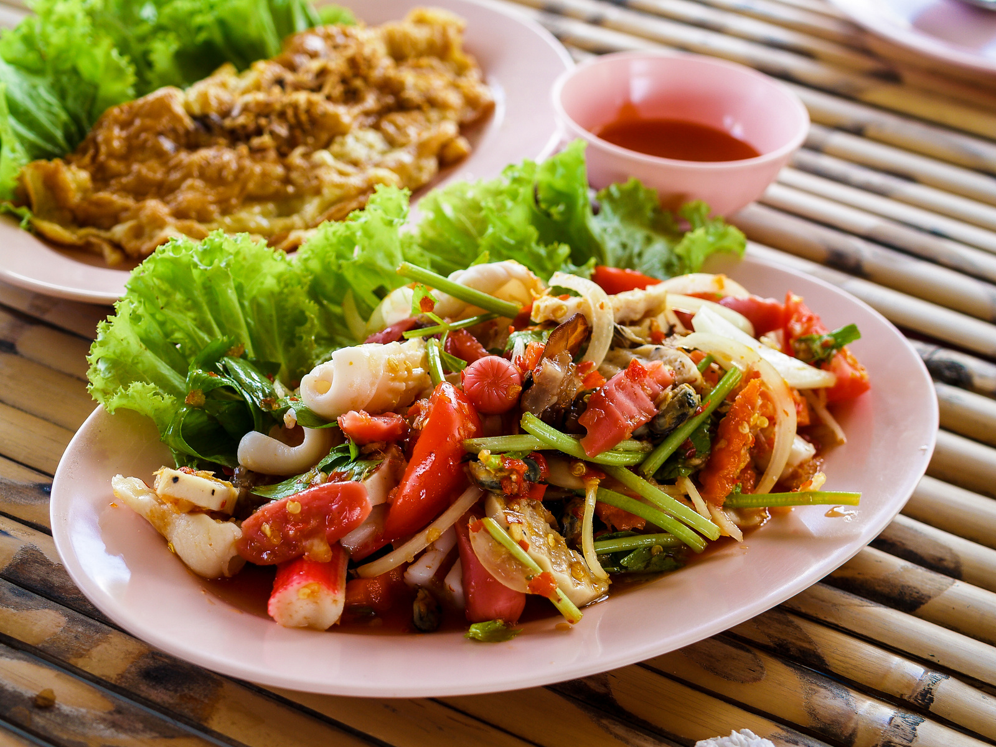

FOODz :
A food delivery app for the campus
Instructor : Dr. Sruti Srinivasa Ragavan
Team Members :
Ammu B
Manjusree Nayak
Saumya Kumari

Slide 2
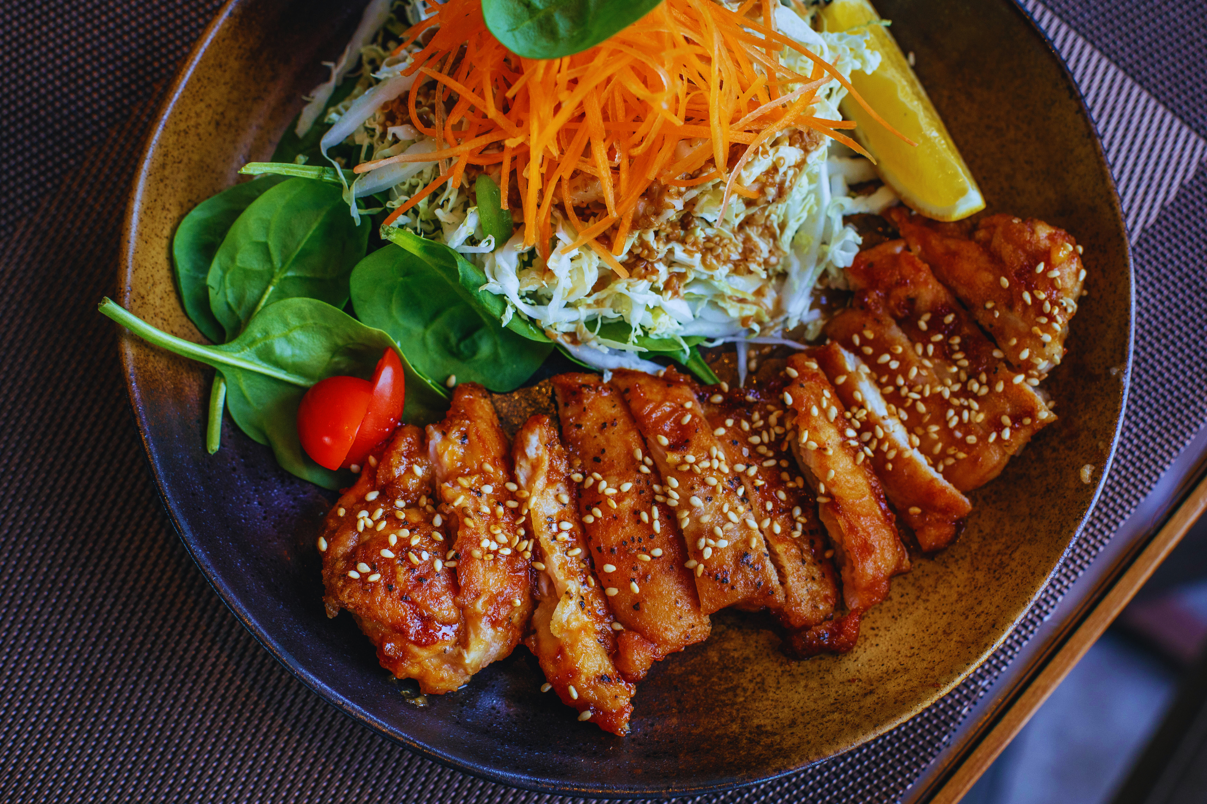
1.
Aim of this Project
The goal of the project is to design a food ordering app for campus residents, ensuring easy access to meals from various hall canteens, food stalls, and campus outlets.*
*This product is inspired by a previous course project developed by Pranab Pandey and his team, with our team member Ammu being part of that project.

Slide 3

The 1st
Needfinding
2.
An anonymous survey with a structured questionnaire designed to identify food-related challenges and preferences among students at IIT Kanpur.
The survey collected data on various aspects, such as eating habits, spending on food outside the mess, challenges in accessing food, popular food choices, and late-night eating behaviour etc.

Slide 4

> 90% felt the need for a late-night snack and faced problems due to inter-hall and delivery restrictions at night
Overcrowding during peak hours or fests and stray animals in dining areas
Distance of these food outlets from residences(~34%) and high prices(~ 15%) affected peoples food choices
Results
&
Inferences
63% of participants have faced difficulty in locating food shops in the campus at least a few times during their stay
Easy to find which outlets are ‘Open’ or ‘closed’ at any particular time, mentioned right under the outlet name
Takeout option was provided where students can pick up their own order
Sorting according to the price from ‘Low to high’ and ‘high to low’ were added for users ease
The outlets are categorised under popular ‘zones’ that will help people locate them even if they don’t remember the shop name.

Slide 5
3.
First Prototype
The first Prototype was made in figma
The Major Features its had were :-
Sign In and a user profile
Homepage divided into zones with the outlets
The cart
A grievances section

Slide 6
The 2nd Needfinding
3.
Observation Sessions with a few major tasks and Semi-structured Interviews were conducted to evaluate the first prototype

Slide 7
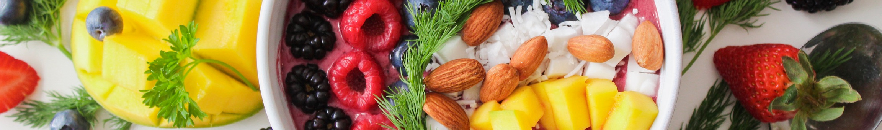
Pain Points & Design Changes
Difficulty in choosing exclusive veg and non-veg options
Veg and nonveg filters were added
Because of the color scheme some features like ‘Add to cart’ were not noticeable
The color scheme was improved and kept uniform. The industry standards were followed for fonts and designs.
There is no way of making changes in the payment details in the cart
Options to change the UPI Id and Card details were added in the cart. Now even multiple addresses are allowed and a choice is provided in the cart.
There was no feedback after placing an order and the subsequent steps after that.
An order status part was added to the home page
No way of cancelling an order after it has been placed
A pop up to show the cancel order option was added with a timer of 2 mins
No way of proceeding if people forget password
Forget password feature was added in the log in pages

Slide 8
Additional features:
A price slider was added to choose the convenient price range
Set budget was added to help keep track of spendings and serve as a gentle reminder for users to not go overboard
Possible additional changes:
Reminders to update profile in the cart
Possible to increase the number of an item in the cart and order pages

Slide 9
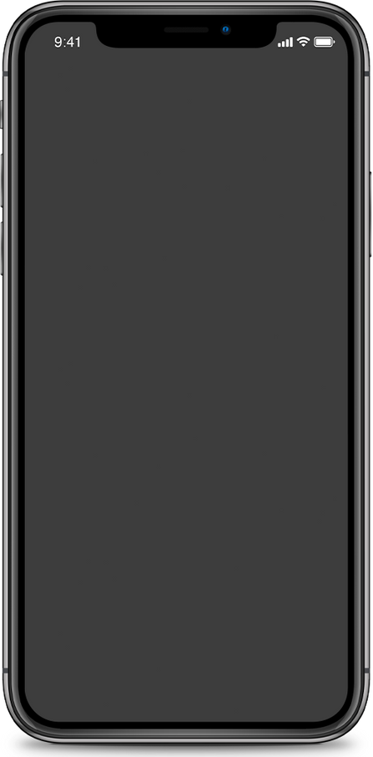
The Final Prototype
It can be found here -
Figma Link

Slide 10
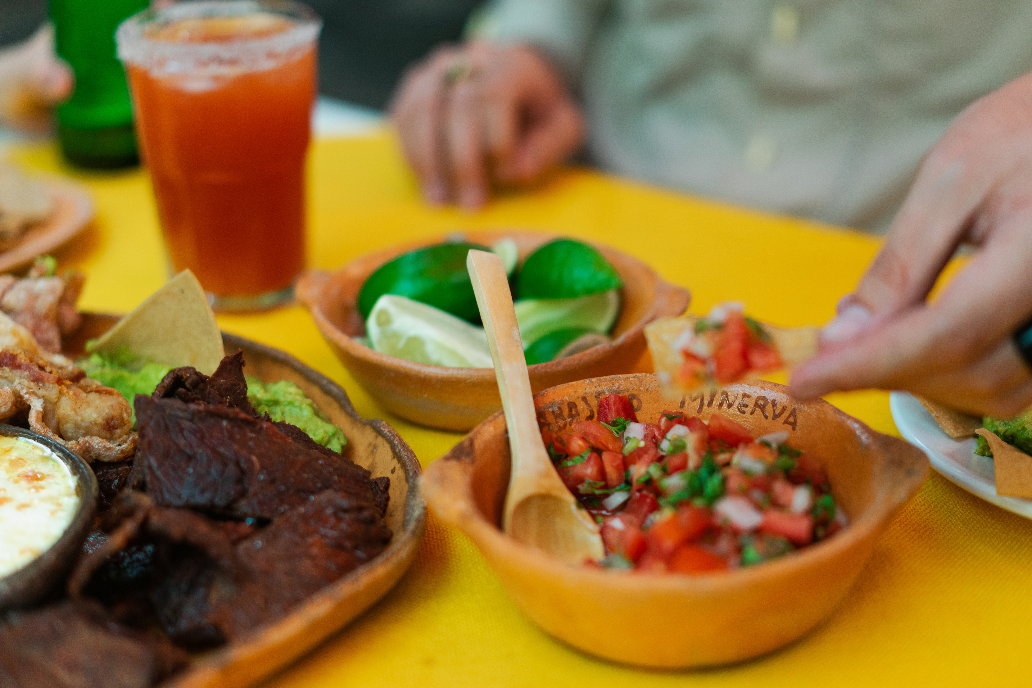
Thank You !!

